Slide 1

Reinforcement Learning for Robot Motion Control
UNIVERSITÀ DEGLI STUDI DI MESSINA
Department of Engineering · PhD in Engineering
Lecturer
Gabriele Rinaldi
Gabriele.rinaldi@studenti.unime.it
+39 3460054769
Academic Year 2026/2027
1/66

Slide 2
Outline
1
Reinforcement Learning foundations
2
Simulators
3
Hands-on: an example project
4
Possible Projects
2/66

Slide 3
Reinforcement Learning Foundations
Section 1
3/66

Slide 4
Example: A Robot Arm That Must Grab an Object
How do we compute the motor commands?
A
Analytical model and trajectory generation (e.g. MPC)
robotic arm
B
Supervised learning using a dataset
C
Reinforcement learning by trial and error
object
Same task, three very different ways to build the controller
4/66
[1] S. Levine. Deep Reinforcement Learning (CS 285), UC Berkeley. Lecture 1 (video)

Slide 5
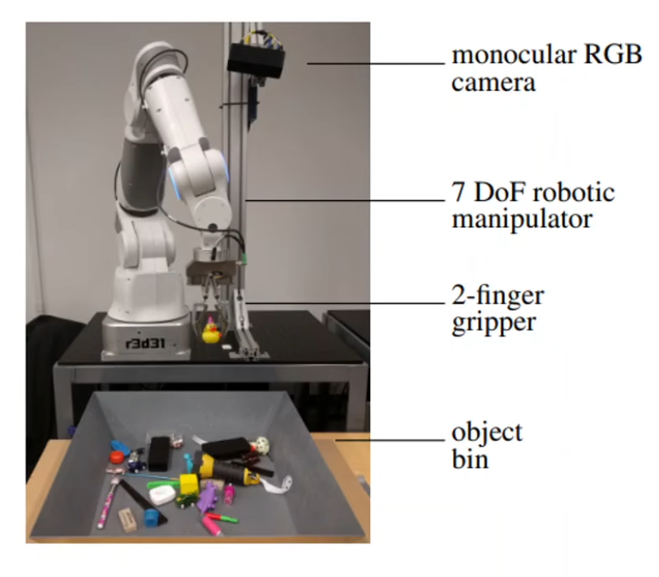
Option A: Analytical Model and MPC
Design an analytical model of the arm and of the object
Compute the trajectories with algorithms such as MPC
Every physical detail must be known in advance: the controller is only as good as the model
The model must capture:
The exact position of the object
The center of mass
Friction and contacts
Powerful, but the model is hard to write and to keep exact
5/66

Slide 6
Option B: Supervised Learning
Input
object position and joint state
Supervised ML model
Output
desired joint positions
It would work… but where do we get the data?
A dataset found online
Generate the data ourselves
+ retargeting of the joints to our robot
…which means building the complex model anyway
IMITATION LEARNING
Supervised learning needs the right answers (labels) to learn from
6/66

Slide 7
Option C: Reinforcement Learning
We do not know how to control the robot: the model cannot be written and we have no data
Try an action
the agent acts in the environment
Idea: trial and error to train a model
How does it learn? By making attempts!
repeated millions of times
How does it know it is doing the right thing? Through reward functions: they reward a correct behavior and punish a wrong one
Improve the model
update the policy
Get a reward
+ good, − bad
The only thing that we formulate is the Reward function
7/66

Slide 8
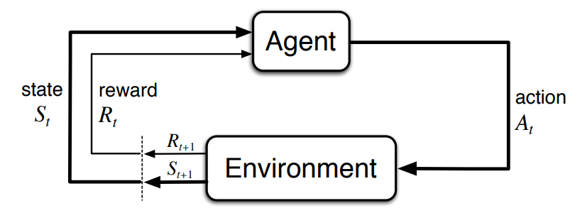
Reinforcement Learning Formulations
The agent observes the state and chooses an action
The environment returns a reward and the next state
The policy guides the agent to choose an action
Goal: maximize the cumulative reward, learned by trial and error
No labeled examples: the agent discovers the behavior that maximizes the reward
8/66
[2] Sutton & Barto. Reinforcement Learning: An Introduction, 2nd ed. (2018)

Slide 9
Markov Decision Process
Formally, RL is described through the mathematical model of Markov Decision Processes (MDP), which makes it possible to model a sequence of actions performed by the agent in the environment and the rewards obtained as a result.
An MDP is defined by the following tuple of elements:
$$M=\left(S , A , P , R , γ\right)$$
9/66
[2] Sutton & Barto. Reinforcement Learning: An Introduction, 2nd ed. (2018)

Slide 10
The Elements of the MDP
where:
S
represents all the possible states in which the agent can be
A
represents all the possible actions that the agent can perform
P(s′ | s, a)
represents the transition probability of moving from state s to state s′ given that action a has been performed
R(s, a)
represents the expected reward obtained by performing action a when the agent was in state s
γ
represents the discount factor, that is, a parameter, with γ ∈ [0, 1], used to balance the immediate reward with respect to future rewards
10/66
[2] Sutton & Barto. Reinforcement Learning: An Introduction, 2nd ed. (2018)

Slide 11
Agent–Environment Interaction
At each time instant t:
The agent observes the state s_{t} ∈ S and performs an action a_{t} ∈ A
Following this action, the agent receives a reward r_{t+1}
The environment moves to a new state s_{t+1}, according to the transition probability:
Interaction between the agent and the environment in reinforcement learning
$$P\left(s_{t+1} | s_{t},a_{t}\right)$$
11/66
[2] Sutton & Barto. Reinforcement Learning: An Introduction, 2nd ed. (2018)

Slide 12
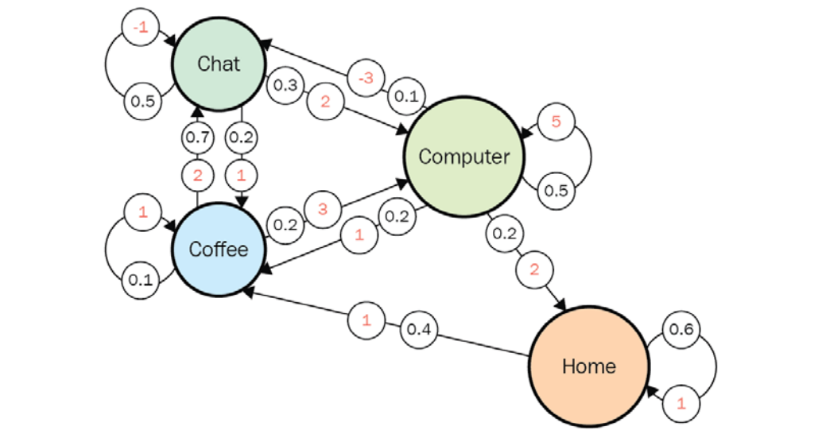
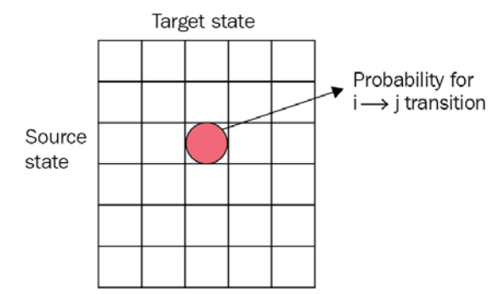
Example: States, Transitions and Rewards
The probabilities collected in a table: each row is a source state, each column a target state
Circles with a red number: the rewards
Black numbers: the transition probabilities from state s to state s′
No actions yet: only the probability of moving from s to s′
$$P\left(s′ | s\right)$$
12/66
[3] M. Lapan. Deep Reinforcement Learning Hands-On, 2nd ed. Packt Publishing (2020)

Slide 13
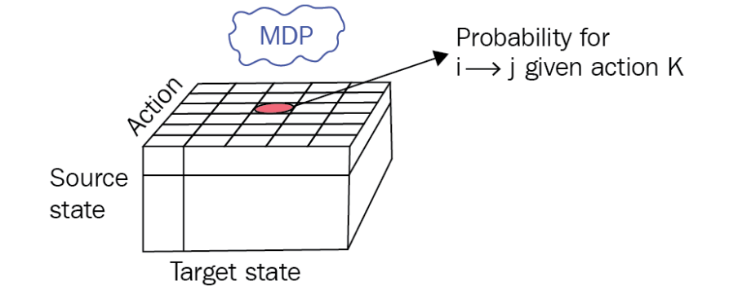
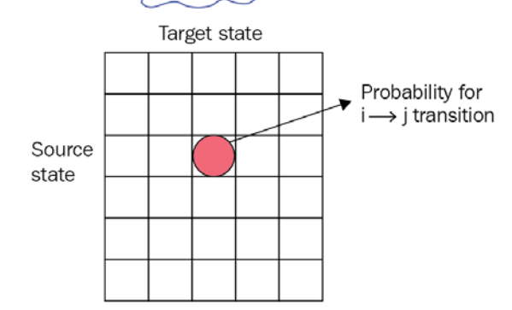
Example: Adding the Actions
If we also consider the possible actions, the table of the transitions becomes a cube
one for each action
Source state × target state × action
For each chosen action, a table of probabilities of moving to a state
For each action a, the probability of moving from s to s′ is
$$P\left(s′ | s,a\right)$$
13/66
[3] M. Lapan. Deep Reinforcement Learning Hands-On, 2nd ed. Packt Publishing (2020)

Slide 14
Total Reward
We are interested in the reward of a sequence of states, not of a single step
The return: a metric of the total reward of a sequence of states
$$G_{t}=\sum_{k=0}^{∞}{γ^{k}r_{t+k+1}}$$
The discount factor γ sets the weight of the following transitions
γ = 0
G_{t} = r_{t+1}
Only the next transition counts
0 < γ < 1
In general γ is around 0.99
The following transitions count, but the further they are, the less they weigh
γ = 1
The whole chain of transitions counts
Only if the sequence of steps is finite: with infinite sequences the reward would be infinite
14/66
[2] Sutton & Barto. Reinforcement Learning: An Introduction, 2nd ed. (2018)

Slide 15
Example: Checkers (Draughts)
×
Good move
captures a piece → positive reward
Bad move
the piece is captured → negative reward
The reward tells the agent what is good, never how to play
15/66

Slide 16
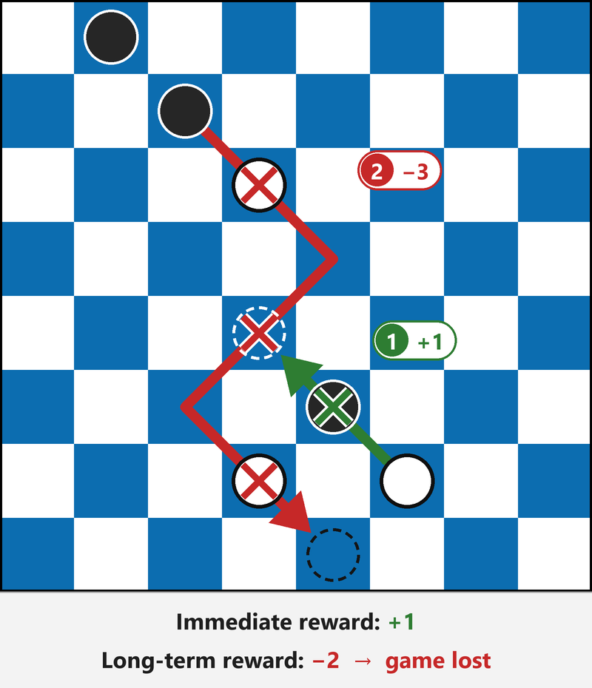
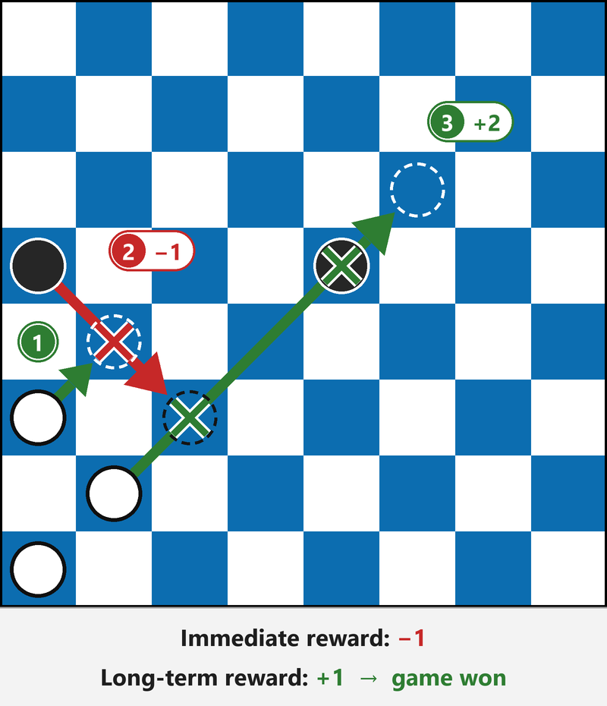
Example: Checkers (Draughts)
16/66

Slide 17
Expected Reward
The return G_{t}
It can be applied only to a specific chain of state transitions
It provides the total reward that this trajectory makes it possible to obtain
By itself it is not very useful: the computed return is specific to that chain
The expected value
The reward that can be obtained starting from a given state
and, in the same way, by performing a given action in that state
Obtained as the average over many chains starting from that state
Not the single trajectory, but the expected value: two equations can be defined
17/66
[2] Sutton & Barto. Reinforcement Learning: An Introduction, 2nd ed. (2018)

Slide 18
Value Functions
State-value function
$$v_{π}\left(s\right)=𝔼_{π}\left[G_{t} | s_{t}=s\right]$$
$$=𝔼_{π}\left[\sum_{k=0}^{∞}{γ^{k}r_{t+k+1}} | s_{t}=s\right]$$
Action-value function
$$q_{π}\left(s , a\right)=𝔼_{π}\left[G_{t} | s_{t}=s,a_{t}=a\right]$$
$$=𝔼_{π}\left[\sum_{k=0}^{∞}{γ^{k}r_{t+k+1}} | s_{t}=s,a_{t}=a\right]$$
The symbol 𝔼_{π} denotes the expected value computed assuming that the agent follows the policy π. Both functions can be estimated from experience.
18/66
[2] Sutton & Barto. Reinforcement Learning: An Introduction, 2nd ed. (2018)

Slide 19
Optimal Policy
The optimal policy is the one that maximizes the expected cumulative reward
The goal: the maximum possible value of the action-value function
$$q_{∗}\left(s , a\right)=\max_{π}{q_{π}\left(s , a\right)}$$
Once q∗ is known, the optimal policy is obtained by choosing, in every state, the action with the highest value
The optimal policy
$$π_{∗}\left(s\right)=\underset{a∈A}{argmax}{q_{∗}\left(s , a\right)}$$
19/66
[2] Sutton & Barto. Reinforcement Learning: An Introduction, 2nd ed. (2018)

Slide 20
Recap
We need Reinforcement Learning when:
No precise analytical model
we cannot design a precise analytical model of the robot and of the environment
No data for imitation learning
we have no data to do the so-called imitation learning, or behavior cloning
The best policy is the one that guarantees the highest reward: the goal of our algorithm is to find the policy that always obtains the maximum possible reward, depending on the state we are in
The optimal policy
$$π_{∗}\left(s\right)=\underset{a∈A}{argmax}{q_{∗}\left(s , a\right)}$$
20/66
[2] Sutton & Barto. Reinforcement Learning: An Introduction, 2nd ed. (2018)

Slide 21
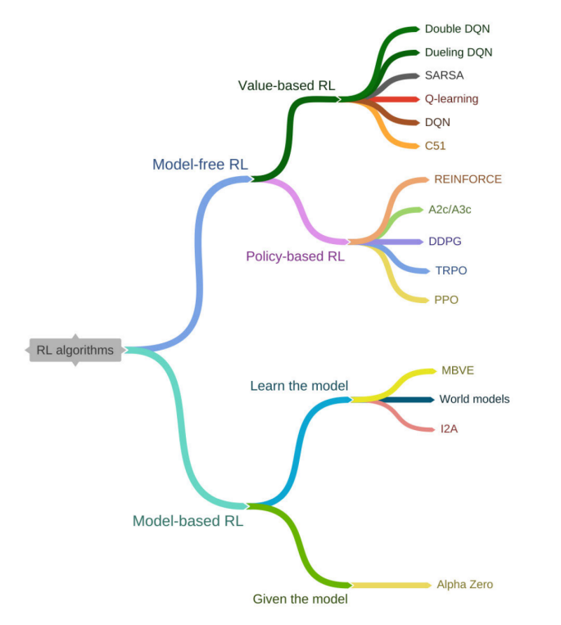
Taxonomy of Reinforcement Learning Algorithms
There are many different algorithms for Reinforcement Learning
We focus on PPO
Proximal Policy Optimization
A model-free and policy-based algorithm
It limits the policy updates (the weight update, similar to backpropagation), so the training stays more stable
The state-of-the-art algorithm for the training of robots
21/66
[4] Khan et al. A Systematic Review on RL-Based Robotics Within the Last Decade. IEEE Access (2020) [5] Schulman et al. Proximal Policy Optimization Algorithms (2017)

Slide 22
The Reward Describes the Task
The only way to describe to the agent the task that we want to perform is to create a reward function
The task
what we want to perform
The reward function
describes the task in the best possible way
The agent
learns the policy that maximizes the reward
The reward function is how we tell the agent what the task is
22/66
[2] Sutton & Barto. Reinforcement Learning: An Introduction, 2nd ed. (2018)

Slide 23
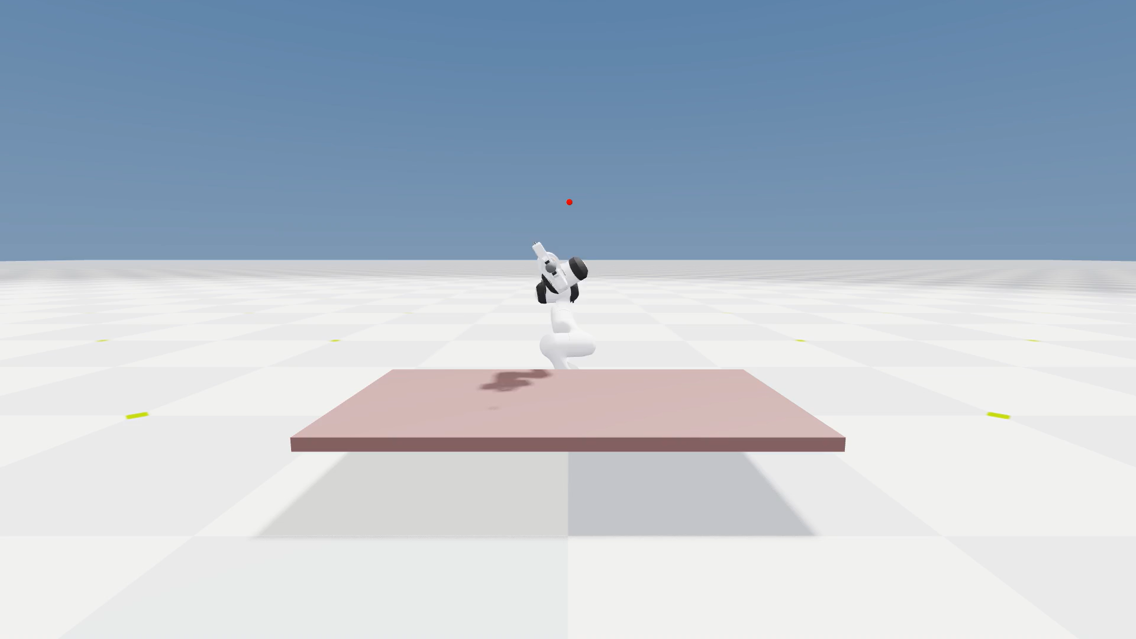

Example: The Reward Shapes the Behavior
The task is done, but with a weird behavior
The task is done with a natural behavior
Constraints = limitations on how the robot is allowed to move
23/66

Slide 24
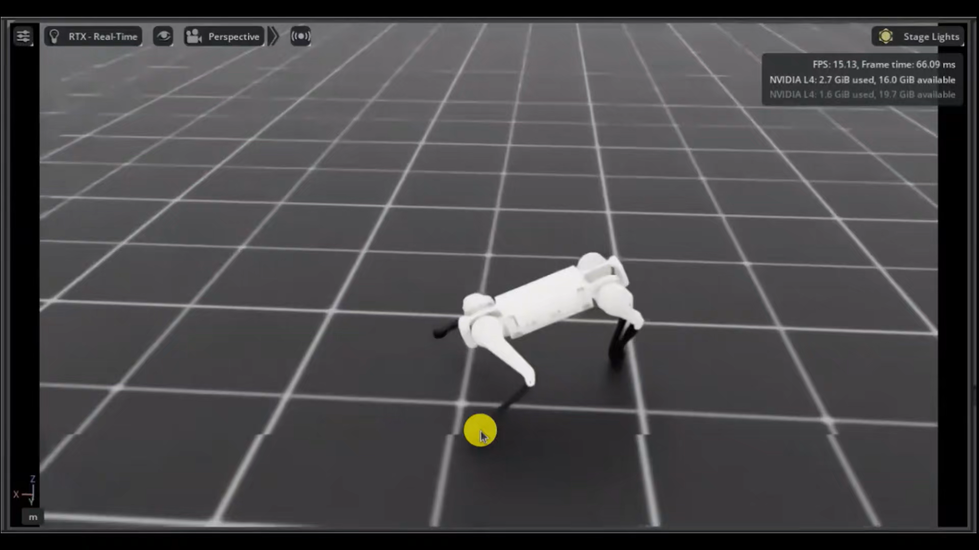
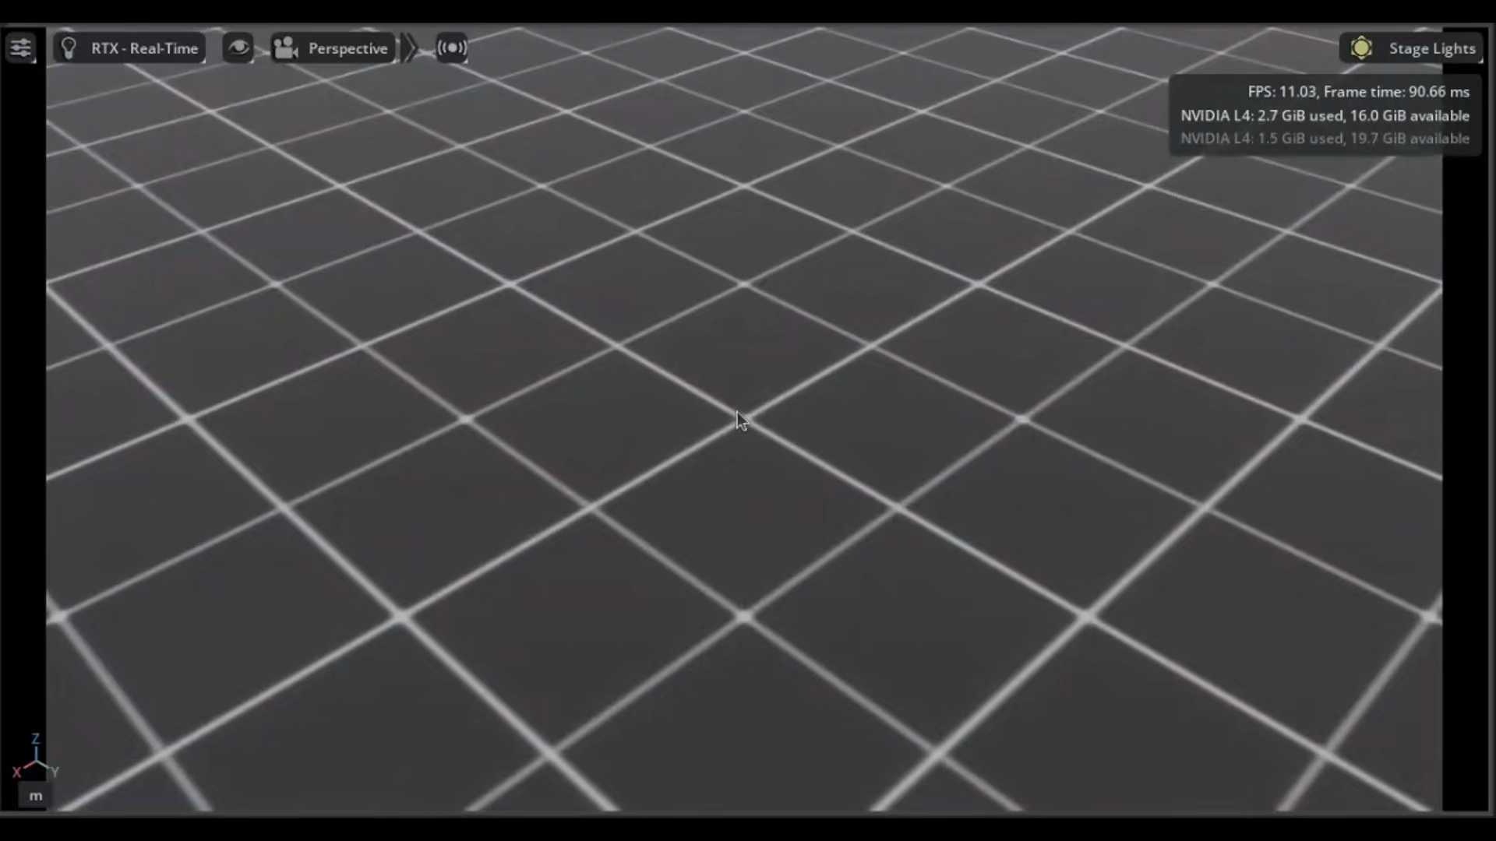
Example: The Reward Shapes the Behavior
The task is done, but with a weird behavior
The task is done with a natural behavior
Constraints = limitations on how the robot is allowed to move
24/66

Slide 25
Simulators
Section 2
25/66

Slide 26
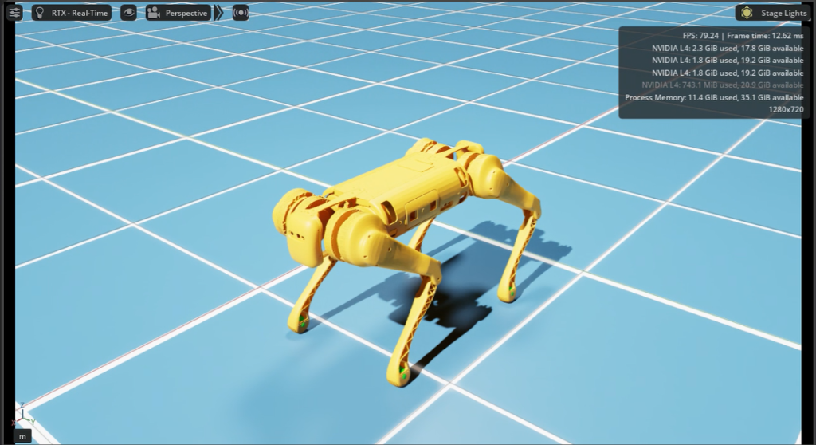
Isaac Lab
Open-source framework for robot learning in GPU-parallel simulation; successor of Isaac Gym
It is not a simulator itself: it is built on top of a physics engine
Shared scene, asset, sensor and task APIs: different physics engines and renderers can be chosen
Isaac Lab 3.0
The Unitree B1 in Isaac Lab, rendered with Isaac Sim
26/66
[6] Mittal et al. Isaac Lab: A GPU-Accelerated Simulation Framework for Multi-Modal Robot Learning (2025) [7] Isaac Lab Documentation, version 3.0. isaac-sim.github.io/IsaacLab

Slide 27
Isaac Lab 3.0: Physics Backends
The same APIs work with different physics backends
Backend | Best fit | Benefits | Trade-offs
Newton | Lightweight training and workflows that can use multiple solver families | Warp-native GPU execution without Isaac Sim; provides MJWarp, VBD, MPM, and other solver paths | Task and feature coverage varies by solver, and changing solvers can require retuning
OvPhysX | Kit-less PhysX workflows | PhysX SDK available through a standalone runtime and can pair with kit-less OVRTX rendering | Cannot be mixed together with Isaac Sim workflows
Isaac Sim PhysX | Isaac Sim workflows that require full Kit integration | PhysX SDK through Isaac Sim and Kit | Requires the larger Isaac Sim and Kit runtime
27/66
[7] Isaac Lab Documentation, version 3.0. isaac-sim.github.io/IsaacLab

Slide 28
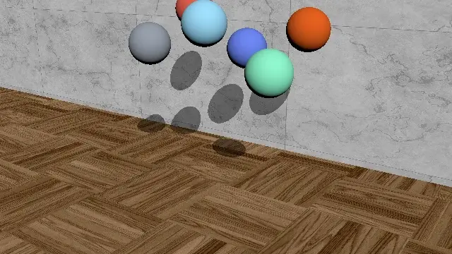
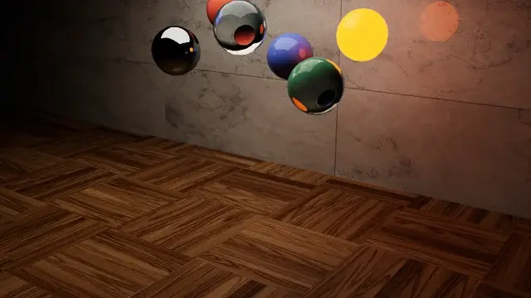

Isaac Lab 3.0: Renderers
Renderer | Best fit | Benefits | Trade-offs
Newton Tiled Camera Sensor | Kit-less training where lightweight camera observations are sufficient at small resolutions | Warp-native raytraced tiled rendering; supports RGB, depth, normals, and semantic and instance segmentation at high throughput | Lower fidelity rendering; minimal support for complex lighting and physics-based materials
OvRTX | Kit-less rendering workflows that require high-fidelity RTX image quality | Higher throughput minimal mode; supports photo-real rendering and can be combined with Newton or OvPhysX without requiring Isaac Sim | Requires the optional ovrtx runtime; may require higher VRAM for high fidelity rendering
Isaac RTX | Isaac Sim-based workflows that require full RTX fidelity and the broadest sensor-output coverage | Higher throughput minimal mode and photo-real rendering integrated with PhysX, Kit, and the Isaac Sim toolchain | Requires the larger Isaac Sim and Kit runtime
Newton Tiled Camera: Lightweight Warp sensor for tiled camera observations
OVRTX: Kit-less RTX materials, lighting, and camera outputs
Isaac RTX: Full RTX fidelity and camera-output coverage in Isaac Sim
28/66
[7] Isaac Lab Documentation, version 3.0. isaac-sim.github.io/IsaacLab

Slide 29
Isaac Lab 3.0: System Requirements
Default installation: Newton with PyTorch
Component | Requirement
Python | Python 3.12. The automatic uv setup manages the environment.
Platform | Ubuntu 22.04+ on x86_64, Linux aarch64 (including DGX Spark), or Windows 11 on x86_64.
GPU training | A CUDA-capable NVIDIA GPU supported by the selected Newton solver and PyTorch. The default CUDA 13 stack requires Turing or newer (compute capability 7.5+).
NVIDIA driver | 595.58.03 on Linux x86_64; 580.159 on Linux aarch64; 595.97 on Windows x86_64. Use a current production driver for your GPU.
Memory | RAM and VRAM needs depend on the task, number of parallel environments, and camera workload. Isaac Sim workstation memory requirements do not apply to a Newton-only installation.
Optional Isaac Sim (isaacsim extra, PhysX workflows): at least 32 GB RAM, 16 GB VRAM and a supported RTX GPU. Headless Newton simulation does not require RTX hardware.
29/66
[7] Isaac Lab Documentation, version 3.0. isaac-sim.github.io/IsaacLab

Slide 30
Isaac Sim: Hardware Requirements
Element | Minimum Spec | Good | Ideal
OS | Ubuntu 22.04/24.04, Windows 11 | Ubuntu 22.04/24.04, Windows 11 | Ubuntu 22.04/24.04, Windows 11
CPU | Intel Core i7 (7th Gen) or AMD Ryzen 5 | Intel Core i7 (9th Gen) or AMD Ryzen 7 | Intel Core i9 X-series or higher, or AMD Ryzen 9 / Threadripper or higher
Cores | 4 | 8 | 16
RAM | 32 GB | 64 GB | 64 GB
Storage | 50 GB SSD | 500 GB SSD | 1 TB NVMe SSD
GPU | GeForce RTX 4080 | GeForce RTX 5080 | RTX PRO 6000 Blackwell
VRAM | 16 GB | 16 GB | 48 GB
Driver | Linux: 595.58.03, Windows: 595.97 | Linux: 595.58.03, Windows: 595.97 | Linux: 595.58.03, Windows: 595.97
Isaac Lab training needs even more RAM and VRAM than these figures
The heavy requirements come from Isaac Sim, not from Isaac Lab
30/66
[8] Isaac Sim Documentation. Requirements. docs.isaacsim.omniverse.nvidia.com

Slide 31
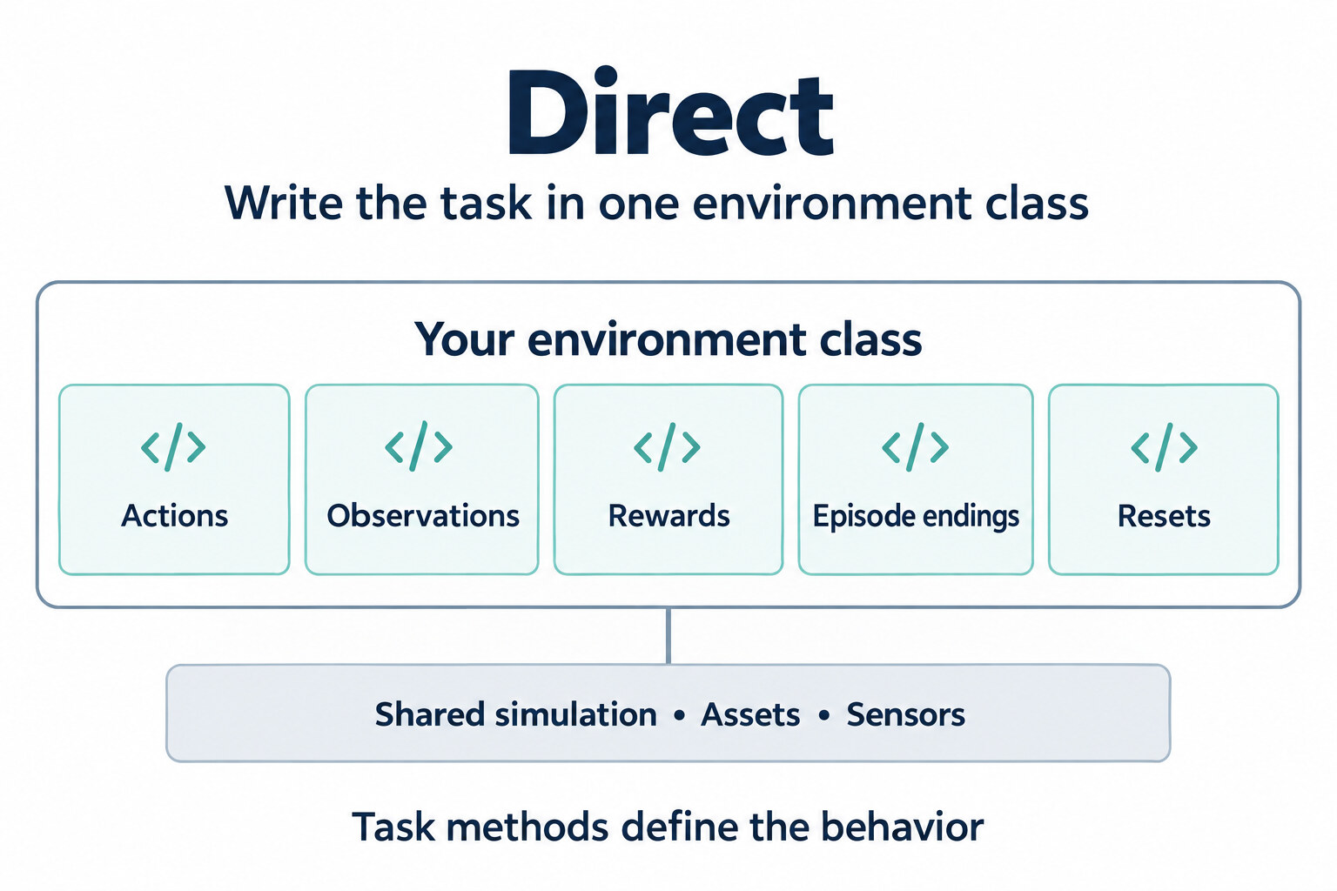
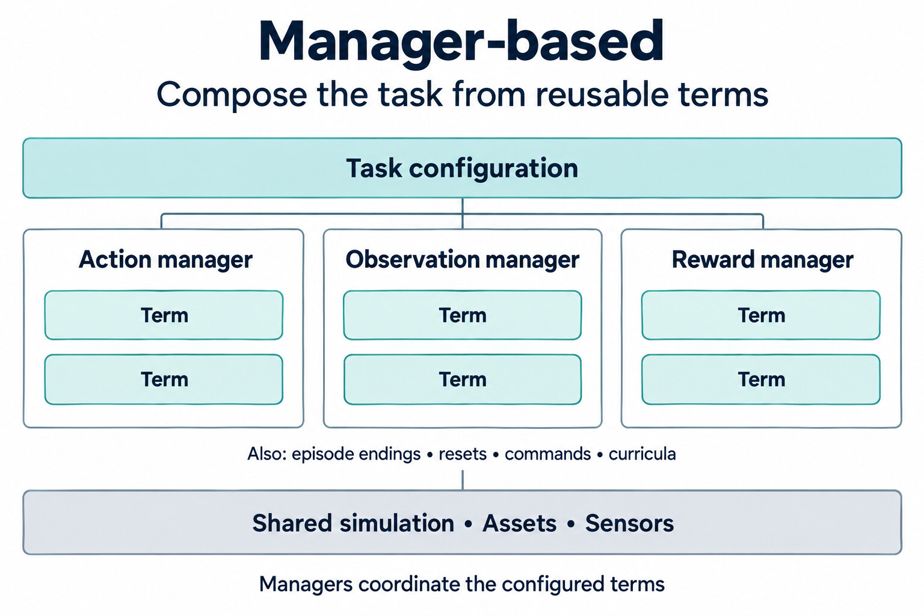
Isaac Lab: Direct and Manager-Based Workflows
 | Direct | Manager-based
Task logic | Implement methods on an environment class. | Configure reusable terms; managers run them.
Changing a task | Edit the methods and helpers that implement its behavior. | Add, replace, or tune terms in its configuration.
A good fit | Closely coupled logic, custom optimization, or multi-agent tasks. | Tasks that share observations, rewards, actions, or reset behavior.
31/66
[7] Isaac Lab Documentation, version 3.0. isaac-sim.github.io/IsaacLab

Slide 32
Isaac Lab: The Managers
Interactive Scene
Gathers the objects, articulated bodies and sensors of the robot
Action Manager
Applies the actions of the policy
Command Manager
Generates the commands for the task
Observation Manager
Collects the observation terms into groups
Reward Manager
Evaluates the reward terms and combines their weighted contributions
Termination Manager
Evaluates the episode termination conditions
Event Manager
Handles events such as resets, domain randomization and external perturbations
Curriculum Manager
Varies the difficulty of the task during the training
Recorder Manager
Records the data produced by the simulation, as episodes of a dataset
Reusable terms coordinated by the managers, under a standard Gymnasium interface
32/66
[7] Isaac Lab Documentation, version 3.0. isaac-sim.github.io/IsaacLab

Slide 33
Isaac Lab: Actuator Models
Two ways to reproduce the behavior of the actuators, the motors that drive the joints
Type | Model | Torque
Implicit | Implicit actuator | The physics solver runs the PD law from the written gains
Explicit | Ideal PD | PD torque, clipped to the symmetric limit of the motor
 | DC motor | PD torque, clipped to a four-quadrant torque-speed envelope
 | Delayed PD | Ideal PD applied to delayed commands
 | Remotized PD | Delayed PD with an angle-dependent torque limit
 | Actuator net (MLP / LSTM) | A trained network predicts the torque from the joint history
 | BAM (Newton only) | Parameter-identified model of a voltage-controlled servo
Each actuator group selects joints with a regular expression on their names and chooses a model
33/66
[7] Isaac Lab Documentation, version 3.0. isaac-sim.github.io/IsaacLab [9] Hwangbo et al. Learning agile and dynamic motor skills for legged robots. Science Robotics (2019)

Slide 34
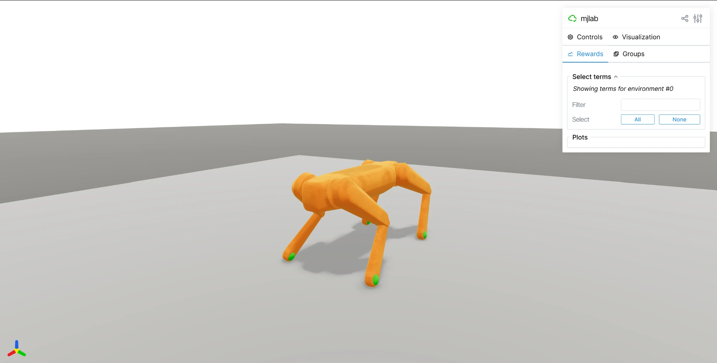
MuJoCo Lab (mjlab)
MuJoCo Lab: a more recent and lightweight framework for robot learning
Same API as Isaac Lab: the same manager-based architecture
MuJoCo Warp physics engine: MuJoCo accelerated on the GPU through NVIDIA Warp
Assets natively in MJCF
The Unitree B1 in the mjlab viewer
34/66
[10] Zakka et al. mjlab: A Lightweight Framework for GPU-Accelerated Robot Learning (2026)

Slide 35
Installation Guides on GitHub
One guide for each simulator and operating system
Linux
Windows
macOS
Isaac Lab
uv
NVIDIA GPU or CPU
uv
NVIDIA GPU or CPU
Docker
Apple Silicon, CPU only
mjlab
uv
NVIDIA GPU or CPU
uv
CPU
uv
Apple Silicon CPU
github.com/GabrieleRinaldi/RL_robots
The guides, with all the commands, are in the installation folder
35/66

Slide 36
Installation Guides on GitHub
Try the installation
36/66

Slide 37
Hands-on: Examples
Section 3
37/66

Slide 38
Creating a New Project from the Template
Answers to the prompts
External project
Parent folder outside IsaacLab: C:\Users\user\prova1
Project name, e.g. prova1
Your name as author e.g. Gabriele,Rinaldi
Initial content: Cartpole
Task family: balance
Robot name: cartpole
No Isaac Sim UI extension
Workflow: Manager-based | single-agent
RL library: rsl_rl with PPO
1
cd C:\Users\user\IsaacLab
Go to the Isaac Lab folder
2
uv run isaaclab --new
Start the project generator and answer the prompts
38/66
[7] Isaac Lab Documentation, version 3.0. isaac-sim.github.io/IsaacLab

Slide 39
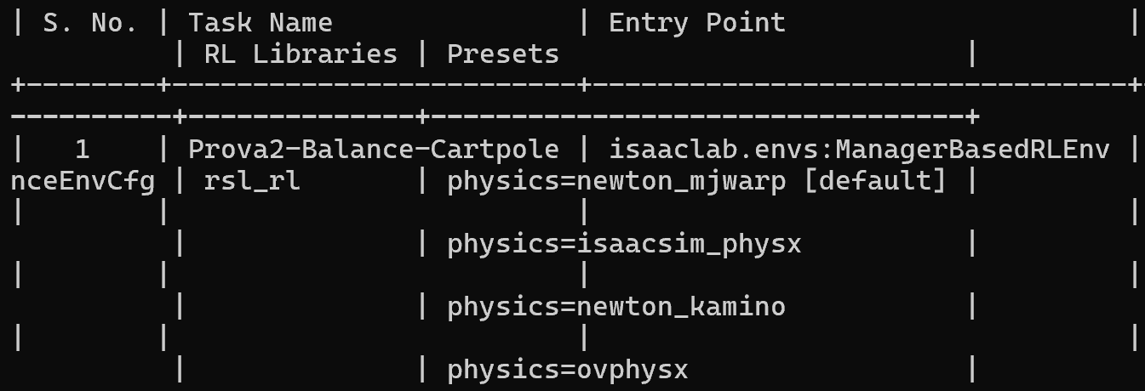
Setting Up the New Project
3
cd C:\Users\user\progetti\my_robot_project
Enter the new project
4
uv sync
Create the environment of the project: Newton, without Isaac Sim (the first time it downloads the dependencies)
5
uv run isaaclab list_envs --show_presets
List the tasks of the project: copy the task name, it is needed in the next commands
39/66
[7] Isaac Lab Documentation, version 3.0. isaac-sim.github.io/IsaacLab

Slide 40
Training and Playing the New Project
Replace <TASK_NAME> with the name copied from the list
uv run isaaclab train --rl_library rsl_rl --task <TASK_NAME>
--device cpu --num_envs 64 --max_iterations 100 physics=newton_mjwarp
6
Train on CPU for 100 iterations
uv run --extra viser isaaclab play --rl_library rsl_rl --task <TASK_NAME>
--device cpu --num_envs 1 physics=newton_mjwarp --checkpoint latest --viz viser
7
Play the last checkpoint: open in the browser the address printed in the terminal
40/66
[7] Isaac Lab Documentation, version 3.0. isaac-sim.github.io/IsaacLab

Slide 41
Structure of the New Project
my_robot_project/
pyproject.toml
dependencies of the project and registration of the tasks
src/my_robot_project/tasks/balance/
config/cartpole/
__init__.py
registers the task with its name
env_cfg.py
the environment: scene, actions, observations, events, rewards, terminations
agents/rsl_rl_ppo_cfg.py
the network and the settings of PPO
mdp/
rewards.py
the functions of the MDP used by the reward terms
Files that we look at: the environment and the functions of the MDP
41/66
[7] Isaac Lab Documentation, version 3.0. isaac-sim.github.io/IsaacLab

Slide 42
Code: Interactive Scene
The Interactive Scene gathers the ground, the robot and the light
@configclass
class BalanceSceneCfg(InteractiveSceneCfg):
# ground plane
ground = AssetBaseCfg(
prim_path="/World/ground",
spawn=sim_utils.GroundPlaneCfg(size=(100.0, 100.0)),
)
# robot
robot: ArticulationCfg = CARTPOLE_CFG.replace(prim_path="{ENV_REGEX_NS}/Robot")
# lights
dome_light = AssetBaseCfg(
prim_path="/World/DomeLight",
spawn=sim_utils.DomeLightCfg(color=(0.9, 0.9, 0.9), intensity=500.0),
)
42/66
File: src/my_robot_project/tasks/balance/config/cartpole/env_cfg.py

Slide 43
Code: Action Manager
The Action Manager turns the output of the policy into a joint effort
@configclass
class ActionsCfg:
joint_effort = mdp.JointEffortActionCfg(asset_name="robot", joint_names=["slider_to_cart"], scale=100.0)
joint_effort: a force applied to the joint slider_to_cart, the cart
scale=100.0: the action of the policy is multiplied by 100
Only the cart is pushed: the pole is not actuated
43/66
File: src/my_robot_project/tasks/balance/config/cartpole/env_cfg.py

Slide 44
Code: Observation Manager
The Observation Manager builds what the policy sees
@configclass
class ObservationsCfg:
@configclass
class PolicyCfg(ObsGroup):
# observation terms (order preserved)
joint_pos_rel = ObsTerm(func=mdp.joint_pos_rel)
joint_vel_rel = ObsTerm(func=mdp.joint_vel_rel)
def __post_init__(self) -> None:
self.enable_corruption = False
self.concatenate_terms = True
# observation groups
policy: PolicyCfg = PolicyCfg()
One group, policy, with two terms: joint positions and joint velocities (relative to the default values)
concatenate_terms: a single vector; enable_corruption = False: no noise on the observations
44/66
File: src/my_robot_project/tasks/balance/config/cartpole/env_cfg.py

Slide 45
Code: Event Manager
@configclass
class EventCfg:
# reset
reset_cart_position = EventTerm(
func=mdp.reset_joints_by_offset,
mode="reset",
params={
"asset_cfg": SceneEntityCfg("robot", joint_names=["slider_to_cart"]),
"position_range": (-1.0, 1.0),
"velocity_range": (-0.5, 0.5),
},
)
reset_pole_position = EventTerm(
func=mdp.reset_joints_by_offset,
mode="reset",
params={
"asset_cfg": SceneEntityCfg("robot", joint_names=["cart_to_pole"]),
"position_range": (-0.25 * math.pi, 0.25 * math.pi),
"velocity_range": (-0.25 * math.pi, 0.25 * math.pi),
},
)
The Event Manager randomizes the initial state at every reset
mode="reset": the events run every time an environment is reset
45/66
File: src/my_robot_project/tasks/balance/config/cartpole/env_cfg.py

Slide 46
Code: Reward Manager
@configclass
class RewardsCfg:
# (1) Constant running reward
alive = RewTerm(func=mdp.is_alive, weight=1.0)
# (2) Failure penalty
terminating = RewTerm(func=mdp.is_terminated, weight=-2.0)
# (3) Primary task: keep pole upright
pole_pos = RewTerm(
func=mdp.joint_pos_target_l2,
weight=-1.0,
params={"asset_cfg": SceneEntityCfg("robot", joint_names=["cart_to_pole"]), "target": 0.0},
)
# (4) Shaping tasks: lower cart velocity
cart_vel = RewTerm(
func=mdp.joint_vel_l1,
weight=-0.01,
params={"asset_cfg": SceneEntityCfg("robot", joint_names=["slider_to_cart"])},
)
# (5) Shaping tasks: lower pole angular velocity
pole_vel = RewTerm(
func=mdp.joint_vel_l1,
weight=-0.005,
params={"asset_cfg": SceneEntityCfg("robot", joint_names=["cart_to_pole"])},
)
46/66
File: src/my_robot_project/tasks/balance/config/cartpole/env_cfg.py

Slide 47
Code: Termination Manager
The Termination Manager decides when an episode ends
@configclass
class TerminationsCfg:
# (1) Time out
time_out = DoneTerm(func=mdp.time_out, time_out=True)
# (2) Cart out of bounds
cart_out_of_bounds = DoneTerm(
func=mdp.joint_pos_out_of_manual_limit,
params={"asset_cfg": SceneEntityCfg("robot", joint_names=["slider_to_cart"]), "bounds": (-3.0, 3.0)},
)
time_out: the episode ends when the time limit is reached
cart_out_of_bounds: the cart leaves the range from -3 to 3
47/66
File: src/my_robot_project/tasks/balance/config/cartpole/env_cfg.py

Slide 48
Code: Environment Configuration
@configclass
class BalanceEnvCfg(ManagerBasedRLEnvCfg):
# Scene settings
scene: BalanceSceneCfg = BalanceSceneCfg(num_envs=4096, env_spacing=4.0)
# Basic settings
observations: ObservationsCfg = ObservationsCfg()
actions: ActionsCfg = ActionsCfg()
events: EventCfg = EventCfg()
# MDP settings
rewards: RewardsCfg = RewardsCfg()
terminations: TerminationsCfg = TerminationsCfg()
# Post initialization
def __post_init__(self) -> None:
"""Post initialization."""
# general settings
self.decimation = 2
self.episode_length_s = 5
# visualizer camera settings
self.sim.visualizer_cfgs = VisualizerCfg(eye=(8.0, 0.0, 5.0))
# simulation settings
self.sim.dt = 1 / 120
self.sim.render_interval = self.decimation
self.sim.physics = BalancePhysicsCfg()
The environment plugs all the configurations together
4096 environments by default, 4 m apart
decimation 2, episode of 5 s, time step 1/120 s
physics: the presets of the next slide
48/66
File: src/my_robot_project/tasks/balance/config/cartpole/env_cfg.py

Slide 49
Code: Physics Presets
@configclass
class BalancePhysicsCfg(PresetCfg):
isaacsim_physx: PhysxCfg = PhysxCfg()
ovphysx: OvPhysxCfg = OvPhysxCfg()
physx: PhysxAutoCfg = PhysxAutoCfg(isaacsim_physx=isaacsim_physx, ovphysx=ovphysx)
newton_mjwarp: NewtonCfg = NewtonCfg(
solver_cfg=MJWarpSolverCfg(
njmax=5,
nconmax=3,
cone="pyramidal",
impratio=1,
integrator="implicitfast",
),
num_substeps=1,
debug_mode=False,
use_cuda_graph=True,
)
newton_kamino: NewtonCfg = NewtonCfg(
solver_cfg=KaminoPADMMSolverCfg(sparse_jacobian=True),
debug_mode=False,
use_cuda_graph=True,
)
default: NewtonCfg = newton_mjwarp
The physics= argument selects one of these presets
physics=newton_mjwarp in our commands: the default; the others are newton_kamino, isaacsim_physx and ovphysx
49/66
File: src/my_robot_project/tasks/balance/config/cartpole/env_cfg.py

Slide 50
Training the Safe and Unsafe Policies
Same task and settings: only the joint-velocity penalties change
uv run isaaclab train --rl_library rsl_rl --task <TASK_NAME>
--device cpu --num_envs 64 --max_iterations 200 --run_name safety
physics=newton_mjwarp
env.rewards.cart_vel.weight=-0.1 env.rewards.pole_vel.weight=-0.05
NVIDIA GPU
If you have one, delete
--device cpu
from the commands
Task name
To check it, use the command in slide 39
8
Safe: the two joint-velocity penalties are 10 times larger than the default (-0.01 and -0.005)
uv run isaaclab train --rl_library rsl_rl --task <TASK_NAME>
--device cpu --num_envs 64 --max_iterations 200 --run_name no_safety
physics=newton_mjwarp
env.rewards.cart_vel=null env.rewards.pole_vel=null
9
Unsafe: the two joint-velocity penalties (cart_vel, pole_vel) are switched off
--run_name adds a suffix to the log folder. Both runs use the same seed (42), so the episodes start from the same initial states
50/66
[7] Isaac Lab Documentation, version 3.0. isaac-sim.github.io/IsaacLab

Slide 51
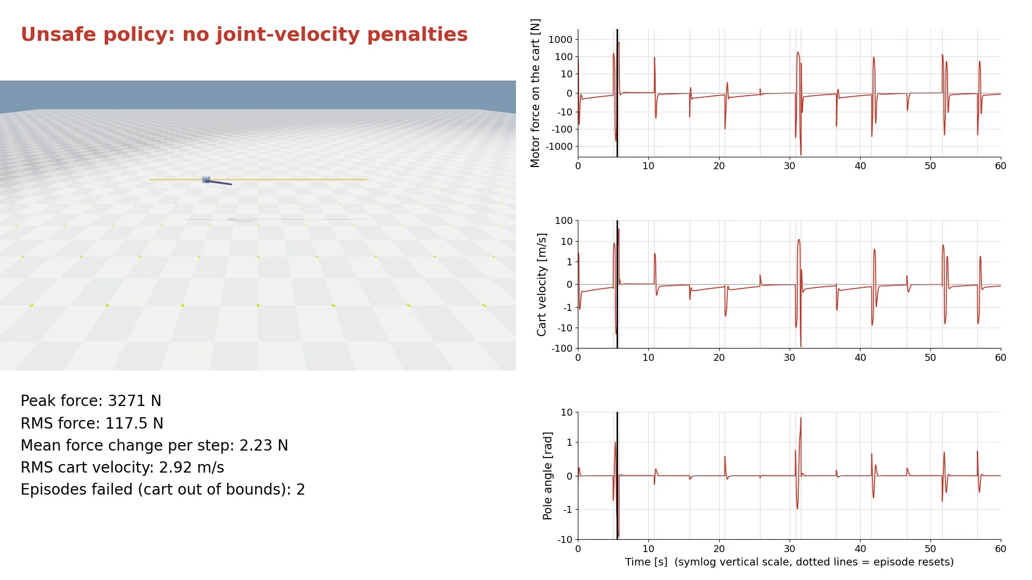
Unsafe Policy: Simulation and Motor Signals
One environment, last checkpoint, 60 s; the plots show the signals of this same run
51/66

Slide 52
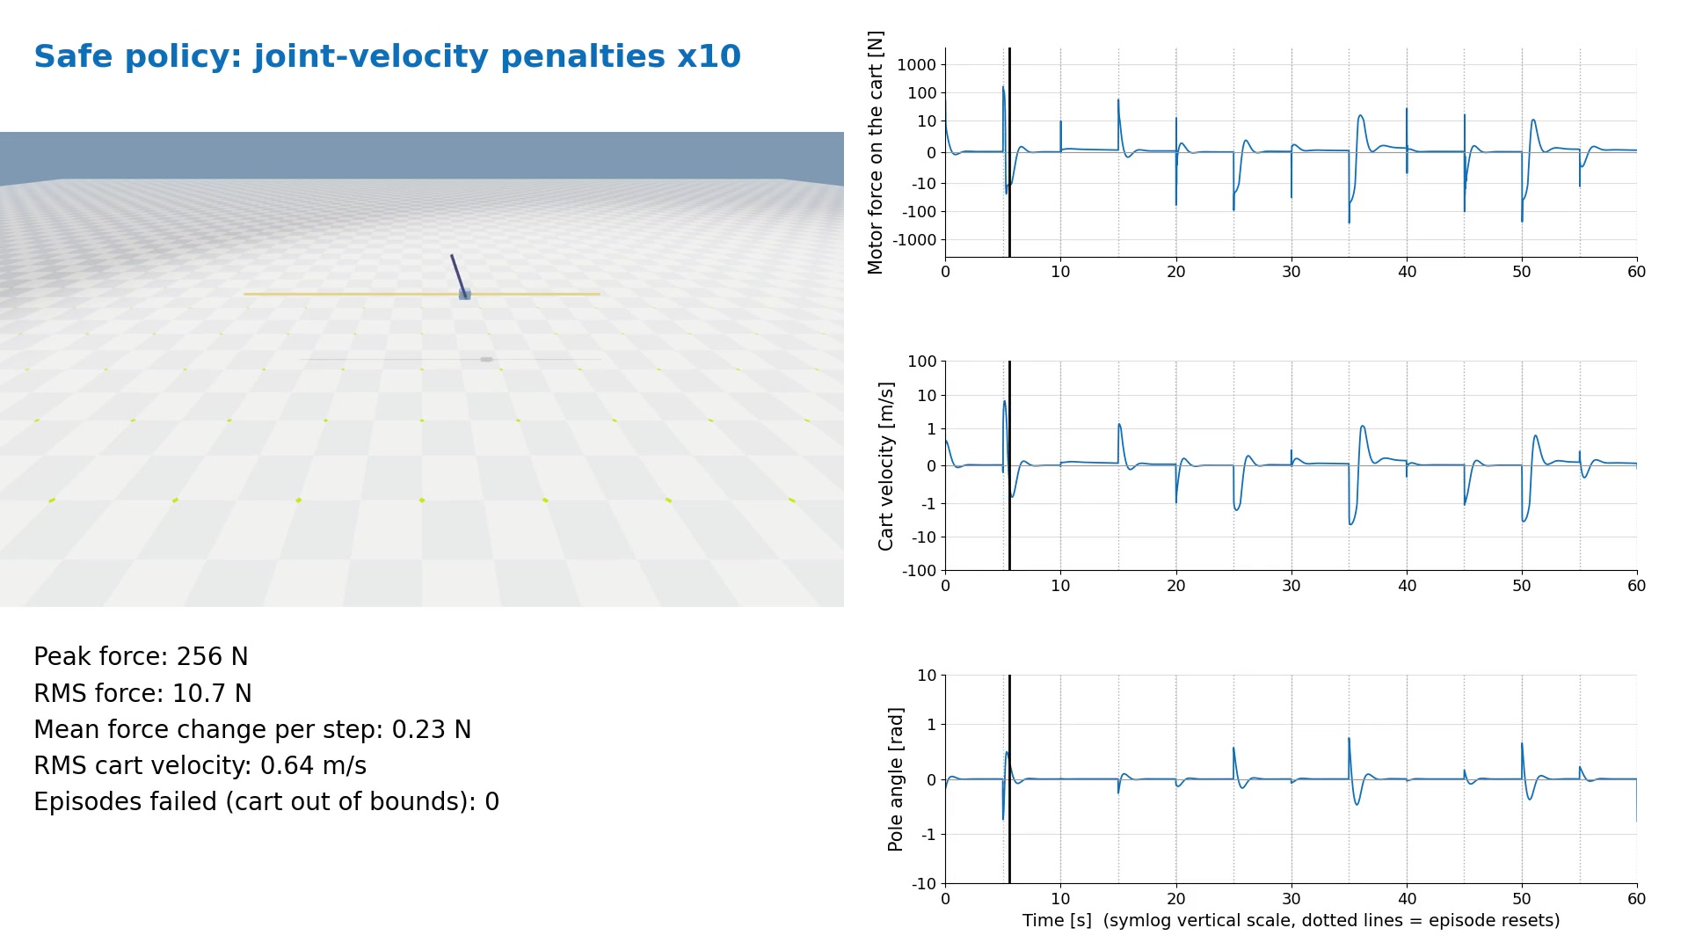
Safe Policy: Simulation and Motor Signals
One environment, last checkpoint, 60 s; the plots show the signals of this same run
52/66

Slide 53
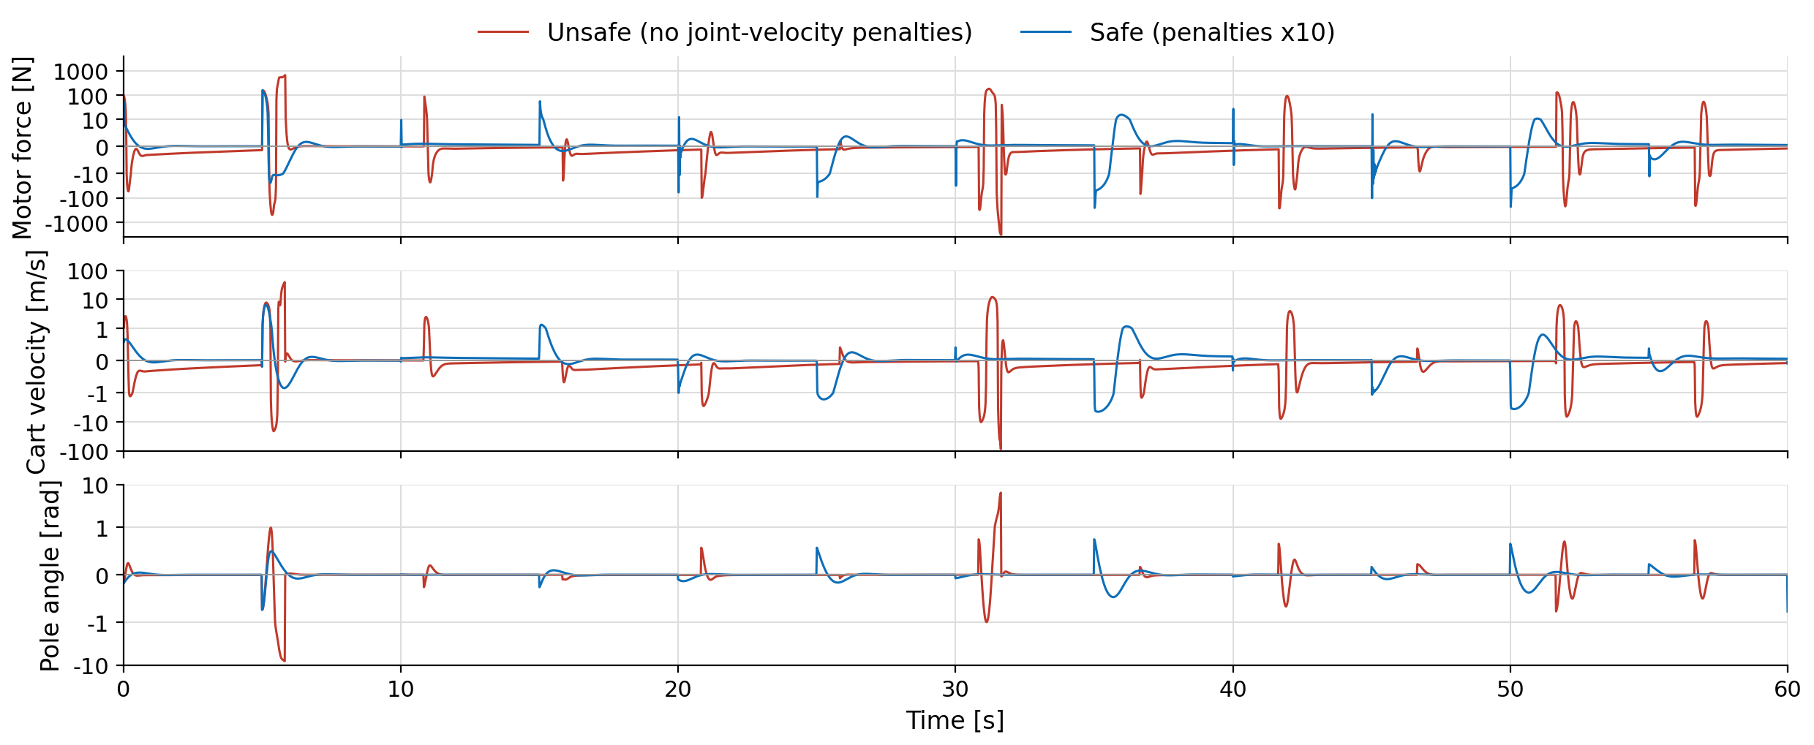
Unsafe vs Safe: Motor Signals Compared
Peak force 3271 N vs 256 N, RMS force 117.5 N vs 10.7 N, mean force change per step 2.23 N vs 0.23 N, episodes failed 2 vs 0 (unsafe vs safe). Vertical axes: symmetric log scale
53/66

Slide 54
The Example: Unitree B1 Locomotion
A locomotion policy for the Unitree B1 quadruped that follows a velocity command
Observations
45 values
Policy
neural network, PPO
Actions
12 joint targets
base angular velocity, projected gravity, velocity command, joint positions and velocities, last action
MLP with three hidden layers (512, 256, 128), trained with PPO (RSL-RL)
one position target for each joint, tracked by the PD controller of the motors
Robot
Unitree B1
about 50 kg, 12 motorized joints
Task
Velocity tracking
forward, lateral and yaw rate
Training
4096 robots in parallel
7 terrain types of growing difficulty
Control
Policy at 50 Hz
episodes of 20 s
18 reward terms: velocity tracking, regularization and gait shaping
54/66
[11] Unitree Robotics. B1 User Manual, V1.0.1 (2022)

Slide 55
B1 Code: Interactive Scene
The scene: a generated terrain, the B1 robot and two sensors
@configclass
class RobotSceneCfg(InteractiveSceneCfg):
# ground terrain
terrain = TerrainImporterCfg(
prim_path="/World/ground",
terrain_type="generator", # "plane", "generator"
terrain_generator=COBBLESTONE_ROAD_CFG, # None, ROUGH_TERRAINS_CFG
max_init_terrain_level=1,
collision_group=-1,
...
)
# robots
robot: ArticulationCfg = B1_CFG.replace(prim_path="{ENV_REGEX_NS}/Robot")
# sensors
height_scanner = RayCasterCfg(
...
)
contact_forces = ContactSensorCfg(prim_path="{ENV_REGEX_NS}/Robot/.*", history_length=3, track_air_time=True)
55/66

Slide 56
B1 Code: Command Manager
The Command Manager samples the velocity command to follow
@configclass
class CommandsCfg:
base_velocity = mdp.UniformLevelVelocityCommandCfg(
asset_name="robot",
resampling_time_range=(10.0, 10.0),
rel_standing_envs=0.1,
debug_vis=True,
ranges=mdp.UniformLevelVelocityCommandCfg.Ranges(
lin_vel_x=(-0.1, 0.1), lin_vel_y=(-0.1, 0.1), ang_vel_z=(-1, 1)
),
limit_ranges=mdp.UniformLevelVelocityCommandCfg.Ranges(
lin_vel_x=(-1.5, 1.5), lin_vel_y=(-1.0, 1.0), ang_vel_z=(-1.5, 1.5)
),
)
resampling_time_range=(10.0, 10.0): a new command every 10 s; rel_standing_envs=0.1: 10% of the robots must stand still
ranges: start small and grow (curriculum), up to the limit_ranges: 1.5 m/s forward, 1 m/s lateral, 1.5 rad/s yaw
56/66

Slide 57
B1 Code: Action Manager
The Action Manager turns the output of the policy into joint position targets
@configclass
class ActionsCfg:
JointPositionAction = mdp.JointPositionActionCfg(
asset_name="robot", joint_names=[".*"], scale=0.25, use_default_offset=True, clip={".*": (-100.0, 100.0)}
)
joint_names=[".*"]: all the 12 joints
scale=0.25, use_default_offset=True: target = default pose + 0.25 × action
The motors track the target with a PD controller (DC-motor model)
57/66

Slide 58
B1 Code: Observation Manager (Policy)
The policy sees 45 values, with noise on the sensors
@configclass
class ObservationsCfg:
@configclass
class PolicyCfg(ObsGroup):
# observation terms (order preserved)
base_ang_vel = ObsTerm(func=mdp.base_ang_vel, scale=0.2, clip=(-100, 100), noise=Unoise(n_min=-0.2, n_max=0.2))
projected_gravity = ObsTerm(func=mdp.projected_gravity, clip=(-100, 100), noise=Unoise(n_min=-0.05, n_max=0.05))
velocity_commands = ObsTerm(
func=mdp.generated_commands, clip=(-100, 100), params={"command_name": "base_velocity"}
)
joint_pos_rel = ObsTerm(func=mdp.joint_pos_rel, clip=(-100, 100), noise=Unoise(n_min=-0.01, n_max=0.01))
joint_vel_rel = ObsTerm(
func=mdp.joint_vel_rel, scale=0.05, clip=(-100, 100), noise=Unoise(n_min=-1.5, n_max=1.5)
)
last_action = ObsTerm(func=mdp.last_action, clip=(-100, 100))
def __post_init__(self):
self.enable_corruption = True
self.concatenate_terms = True
# observation groups
policy: PolicyCfg = PolicyCfg()
58/66

Slide 59
B1 Code: Observation Manager (Critic)
@configclass
class CriticCfg(ObsGroup):
base_lin_vel = ObsTerm(func=mdp.base_lin_vel, clip=(-100, 100))
base_ang_vel = ObsTerm(func=mdp.base_ang_vel, scale=0.2, clip=(-100, 100))
projected_gravity = ObsTerm(func=mdp.projected_gravity, clip=(-100, 100))
velocity_commands = ObsTerm(
func=mdp.generated_commands, clip=(-100, 100), params={"command_name": "base_velocity"}
)
joint_pos_rel = ObsTerm(func=mdp.joint_pos_rel, clip=(-100, 100))
joint_vel_rel = ObsTerm(func=mdp.joint_vel_rel, scale=0.05, clip=(-100, 100))
joint_effort = ObsTerm(func=mdp.joint_effort, scale=0.01, clip=(-100, 100))
last_action = ObsTerm(func=mdp.last_action, clip=(-100, 100))
height_scanner = ObsTerm(func=mdp.height_scan,
params={"sensor_cfg": SceneEntityCfg("height_scanner")},
clip=(-1.0, 5.0),
)
def __post_init__(self):
self.history_length = 5
# privileged observations
critic: CriticCfg = CriticCfg()
59/66

Slide 60
B1 Code: Event Manager
@configclass
class EventCfg:
# startup
physics_material = EventTerm(
func=mdp.randomize_rigid_body_material,
mode="startup",
params={
"asset_cfg": SceneEntityCfg("robot", body_names=".*"),
"static_friction_range": (0.3, 1.2),
"dynamic_friction_range": (0.3, 1.2),
"restitution_range": (0.0, 0.15),
"num_buckets": 64,
},
)
...
# interval
push_robot = EventTerm(
func=mdp.push_by_setting_velocity,
mode="interval",
interval_range_s=(7.0, 10.0),
params={"velocity_range": {"x": (-1.0, 1.0), "y": (-1.0, 1.0)}},
)
The Event Manager randomizes the robot and pushes it during the training
mode="startup": friction and restitution are randomized once (the base mass too, omitted)
mode="interval": every 7 to 10 s the robot gets a random push, up to 1 m/s in x and y
Omitted: the reset events, with random pose and joint velocities
60/66

Slide 61
B1 Code: Reward Manager (1/2)
Tracking the command, staying alive, and penalties on the base and the joints
@configclass
class RewardsCfg:
# -- task
track_lin_vel_xy = RewTerm(
func=mdp.track_lin_vel_xy_exp, weight=1.5, params={"command_name": "base_velocity", "std": math.sqrt(0.25)}
)
track_ang_vel_z = RewTerm(
func=mdp.track_ang_vel_z_exp, weight=0.75, params={"command_name": "base_velocity", "std": math.sqrt(0.25)}
)
alive = RewTerm(func=mdp.is_alive, weight=0.2)
# -- base
base_linear_velocity = RewTerm(func=mdp.lin_vel_z_l2, weight=-2.0)
base_angular_velocity = RewTerm(func=mdp.ang_vel_xy_l2, weight=-0.05)
joint_vel = RewTerm(func=mdp.joint_vel_l2, weight=-0.001)
joint_acc = RewTerm(func=mdp.joint_acc_l2, weight=-2.5e-7)
joint_torques = RewTerm(func=mdp.joint_torques_l2, weight=-2e-5)
action_rate = RewTerm(func=mdp.action_rate_l2, weight=-0.1)
dof_pos_limits = RewTerm(func=mdp.joint_pos_limits, weight=-10.0)
energy = RewTerm(func=mdp.energy, weight=-2e-5)
61/66

Slide 62
B1 Code: Reward Manager (2/2)
@configclass
class RewardsCfg:
...
feet_air_time = RewTerm(
func=mdp.feet_air_time,
weight=0.1,
params={
"sensor_cfg": SceneEntityCfg("contact_forces", body_names=".*_foot"),
"command_name": "base_velocity",
"threshold": 0.5,
},
)
air_time_variance = RewTerm(
func=mdp.air_time_variance_penalty,
weight=-1.0,
params={"sensor_cfg": SceneEntityCfg("contact_forces", body_names=".*_foot")},
)
feet_slide = RewTerm(
func=mdp.feet_slide,
weight=-0.1,
params={
"asset_cfg": SceneEntityCfg("robot", body_names=".*_foot"),
"sensor_cfg": SceneEntityCfg("contact_forces", body_names=".*_foot"),
},
)
Gait terms: how the feet move
feet_air_time: rewards the steps whose air time is above 0.5 s
air_time_variance: penalizes air times that are different among the feet
feet_slide: penalizes a foot that slides on the ground
62/66

Slide 63
B1 Code: Termination Manager
The Termination Manager decides when an episode ends
@configclass
class TerminationsCfg:
time_out = DoneTerm(func=mdp.time_out, time_out=True)
base_contact = DoneTerm(
func=mdp.illegal_contact,
params={"sensor_cfg": SceneEntityCfg("contact_forces", body_names="trunk"), "threshold": 1.0},
)
bad_orientation = DoneTerm(func=mdp.bad_orientation, params={"limit_angle": 0.8})
time_out: the episode ends after 20 s
base_contact: the trunk touches something (contact force above 1 N)
bad_orientation: the trunk is tilted by more than 0.8 rad
63/66

Slide 64
B1 Code: Curriculum Manager
The Curriculum Manager makes the task harder as the robots improve
@configclass
class CurriculumCfg:
terrain_levels = CurrTerm(func=mdp.terrain_levels_vel)
lin_vel_cmd_levels = CurrTerm(mdp.lin_vel_cmd_levels)
terrain_levels_vel: a robot that walks far enough goes to a harder terrain; one that walks too little goes back
lin_vel_cmd_levels: when the tracking reward is high, the range of the velocity command grows
64/66

Slide 65
B1 Code: Environment Configuration
@configclass
class B1BayesianOptimizationTrainingEnvCfg(ManagerBasedRLEnvCfg):
# Scene settings
scene: RobotSceneCfg = RobotSceneCfg(num_envs=4096, env_spacing=2.5)
# Basic settings
observations: ObservationsCfg = ObservationsCfg()
actions: ActionsCfg = ActionsCfg()
commands: CommandsCfg = CommandsCfg()
# MDP settings
rewards: RewardsCfg = RewardsCfg()
terminations: TerminationsCfg = TerminationsCfg()
events: EventCfg = EventCfg()
curriculum: CurriculumCfg = CurriculumCfg()
def __post_init__(self):
# general settings
self.decimation = 4
self.episode_length_s = 20.0
# simulation settings
self.sim.dt = 0.005
self.sim.render_interval = self.decimation
...
The environment plugs all the configurations together
4096 environments, 2.5 m apart
decimation 4 and time step 0.005 s: the policy runs at 50 Hz; episodes of 20 s
65/66

Slide 66
Projects
Work in progress
66/66

Slide 67
References
[1] S. Levine. CS 285: Deep Reinforcement Learning, UC Berkeley. Lecture videos: youtube.com/watch?v=DD8APgTEix4
[2] R. S. Sutton and A. G. Barto. Reinforcement Learning: An Introduction, 2nd ed. MIT Press (2018).
[3] M. Lapan. Deep Reinforcement Learning Hands-On, 2nd ed. Packt Publishing (2020).
[4] M. A.-M. Khan et al. A Systematic Review on Reinforcement Learning-Based Robotics Within the Last Decade. IEEE Access 8, 176598-176623 (2020). doi:10.1109/ACCESS.2020.3027152
[5] J. Schulman et al. Proximal Policy Optimization Algorithms. arXiv:1707.06347 (2017).
[6] M. Mittal et al. Isaac Lab: A GPU-Accelerated Simulation Framework for Multi-Modal Robot Learning. arXiv:2511.04831 (2025).
[7] Isaac Lab Documentation, version 3.0. isaac-sim.github.io/IsaacLab
[8] Isaac Sim Documentation. Requirements. docs.isaacsim.omniverse.nvidia.com
[9] J. Hwangbo et al. Learning agile and dynamic motor skills for legged robots. Science Robotics 4(26), eaau5872 (2019). doi:10.1126/scirobotics.aau5872
[10] K. Zakka et al. mjlab: A Lightweight Framework for GPU-Accelerated Robot Learning. arXiv:2601.22074 (2026).
[11] Unitree Robotics. B1 User Manual, V1.0.1 (2022).
67/66

